Slide 1
SQL JOIN
A JOIN combines records from two tables.
JOIN matches related column values in two tables.
A query can contain zero, one, or multiple JOIN operations.

Slide 2
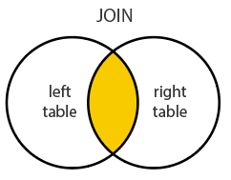
Example:

Slide 3
SQL JOIN Types
TYPE | DESCRIPTION
JOIN | Match records in both tables
LEFT JOIN | Match left (first) table records with right table records
RIGHT JOIN | Match right (last) table records with left table records
FULL JOIN | Include all left and right records whether they match or not

Slide 4
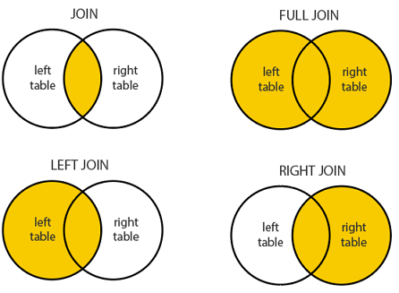
SQL JOIN Diagram:

Slide 5
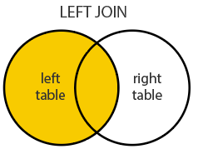
SQL LEFT JOIN
A LEFT JOIN performs a join starting with the left table.
Then, any matching records from the right table will be included.
Rows without a match will have NULL column values.

Slide 6
LEFT JOIN syntax
SELECT column-names FROM table-name1 LEFT JOIN table-name2 ON column-name1 = column-name2 WHERE condition
LEFT OUTER JOIN syntax. SELECT column-names FROM table-name1 LEFT OUTER JOIN table-name2 ON column-name1 = column-name2 WHERE condition

Slide 7
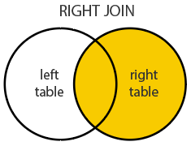
SQL RIGHT JOIN
A RIGHT JOIN performs a join starting with the right table.
Then, any matching records from the left table will be included.
Rows without a match will have NULL column values.

Slide 8
RIGHT JOIN syntax.
SELECT column-names
FROM table-name1
RIGHT JOIN table-name2 ON column-name1 = column-name2
WHERE condition
RIGHT OUTER JOIN syntax.
SELECT column-names
FROM table-name1
RIGHT OUTER JOIN table-name2 ON column-name1 = column-name2
WHERE condition

Slide 9
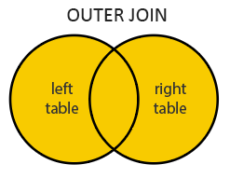
SQL FULL JOIN
A FULL JOIN returns all records from both tables.
This includes records that do not match.
Rows without a match will have NULL column values.

Slide 10
FULL JOIN syntax.
SELECT column-names
FROM table-name1
FULL JOIN table-name2 ON column-name1 = column-name2
WHERE condition
FULL OUTER JOIN syntax.
SELECT column-names
FROM table-name1
FULL OUTER JOIN table-name2 ON column-name1 = column-name2
WHERE condition
FULL JOIN and FULL OUTER JOIN are the same. The OUTER keyword is optional.

